Slide 1
Ellis Summer School - 2023
Total Budget consumed @LEONARDO: 8825 GPU/H (367 days + 17 hours)
Group Awards:
Group Consuming Most Budget
Group with highest success rate on SLURM jobs
Group using Most GPUs
Individual Awards
User Consuming Most Budget
User with highest success rate on SLURM jobs
User using Most GPUs

Slide 2
Group Consuming Most Budget
+-------+---------------------------------+---------+
| Group | Budget Consumed | % Total |
|-------+---------------------------------+---------|
| 1 | 2035 GPU/H (84 days + 19 hours) | 23.07 |
| 8 | 1839 GPU/H (76 days + 15 hours) | 20.84 |
| 12 | 1317 GPU/H (54 days + 21 hours) | 14.93 |
| 6 | 810 GPU/H (33 days + 18 hours) | 9.18 |
| 11 | 764 GPU/H (31 days + 20 hours) | 8.66 |
+-------+---------------------------------+---------+

Slide 3
SLURM Master Group (highest success rate)
+-------+---------------+----------+
| Group | % Job Success | Num Jobs |
|-------+---------------+----------|
| 12 | 91.45 | 269 |
| 11 | 74.86 | 366 |
| 7 | 66.90 | 290 |
| 3 | 46.53 | 101 |
| 1 | 36.32 | 234 |
+-------+---------------+----------+

Slide 4
Group using Most GPUs
+-------+----------+
| Group | Num GPUs |
|-------+----------|
| 11 | 1464 |
| 1 | 1436 |
| 8 | 1352 |
| 7 | 1160 |
| 12 | 1076 |
+-------+----------+

Slide 5
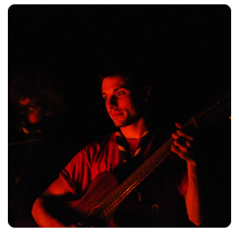
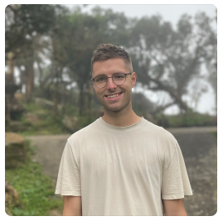
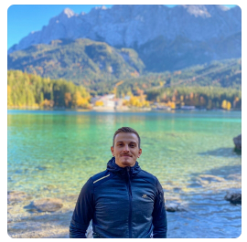
User Consuming Most Budget
+----------+---------------------------------+----------+----------------+------------+
| Username | Budget Consumed | % Total | Name | Surname |
|----------+---------------------------------+----------+----------------+------------|
| a08trb15 | 1237 GPU/H (51 days + 13 hours) | 14.03 | Emanuele | Frascaroli |
| a08tra03 | 1136 GPU/H (47 days + 8 hours) | 12.88 | Vitus | Benson |
| a08trb07 | 929 GPU/H (38 days + 17 hours) | 10.53 | Roberto | Amoroso |
| a08tra47 | 789 GPU/H (32 days + 21 hours) | 8.95 | Simone Alberto | Peirone |
| a08tra73 | 629 GPU/H (26 days + 5 hours) | 7.13 | Federico | Betti |
| a08tra68 | 581 GPU/H (24 days + 5 hours) | 6.58 | Mingxiao | Li |
| a08trb11 | 560 GPU/H (23 days + 8 hours) | 6.35 | Robin San | Roman |
+----------+---------------------------------+----------+----------------+------------+

Slide 6
SLURM Master
The man who whispers to SLURM
+----------+---------------+----------+------------+------------+
| Username | % Job Success | Num Jobs | Name | Surname |
|----------+---------------+----------+------------+------------|
| a08trb15 | 93.08 | 260 | Emanuele | Frascaroli |
| a08tra60 | 87.14 | 280 | Putra | Manggala |
| a08trb07 | 85.90 | 78 | Roberto | Amoroso |
| a08tra82 | 78.86 | 246 | Alessandro | Simoni |
| a08trb14 | 66.67 | 51 | Enrico | Martini |
+----------+---------------+----------+------------+------------+

Slide 7
User who used Most GPUs
+------------+----------+------------+------------+
| Username | num GPUs | name | surname |
|------------+----------+------------+------------|
| a08tra60 | 1120 | Putra | Manggala |
| a08trb15 | 1040 | Emanuele | Frascaroli |
| a08tra82 | 984 | Alessandro | Simoni |
| a08tra13 | 832 | Francesco | Tonini |
| a08tra03 | 604 | Vitus | Benson |
| a08tra63 | 548 | Nicola | Dall'Asen |
| a08tra65 | 476 | Emanuele | Vivoli |
+------------+----------+------------+------------+

